Slide 1
Homework 3 (Discussion)
Try to google: When and where the earliest profiles of temperature and salinity were obtained?
T | S | TS
1853 | 1977 | 1916 (Bjorn Helland-Hansen x3, TS diagram), 1925, 1970 (CTD)
? | From space? | 大西洋
When
Where

Slide 2
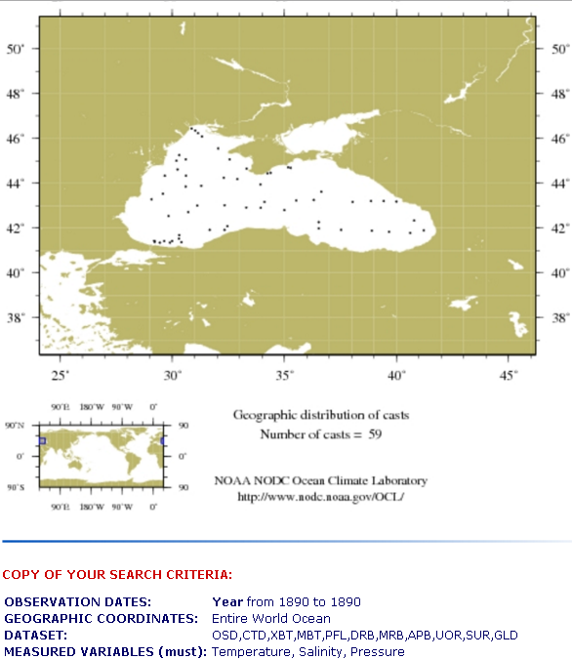
1890
NOAA
Notes:
https://www.nodc.noaa.gov/OC5/WOD09/wod_programs.html
https://www.nodc.noaa.gov/cgi-bin/OC5/WOD09/getyearlydata.pl

Slide 3
Comparison, links and sources
https://www.researchgate.net/figure/Temperature-and-salinity-section-from-75-02-N-33-30-E-Central-Bank-to-72-29-N_fig9_258540655
https://divediscover.whoi.edu/history-of-oceanography/
http://w3.oc.ntu.edu.tw/chap6/chap6.htm
https://drive.google.com/file/d/1WvyJJuf-QYL537e_y5GmvZ6t_Sy_z-N_/view?usp=sharing
https://oceanobservatories.org/2011/06/ctd-101/
https://www.whoi.edu/press-room/obituary/neil-brown/
https://www.researchgate.net/publication/276849288_A_brief_history_of_Physical_Oceanography_In_Ocean_Digest_Quarterly_Newsletter_of_Ocean_Society_of_IndiaISSN2394-1928_042015_Volume_228-12
https://www.sciencedirect.com/topics/earth-and-planetary-sciences/physical-oceanography
https://www.uv.es/hegigui/Kasper/por%20Robert%20H%20Stewart.pdf
https://books.google.com.tw/books?id=UYk7UE6Cov8C&pg=PA119&lpg=PA119&dq=the+first+t-s+diagram+in+the+world&source=bl&ots=VKLpsztL0G&sig=ACfU3U1DG5qTivjyUOoLoNOJnzR5YGrJKA&hl=zh-TW&sa=X&ved=2ahUKEwjksrqk8bDoAhWO-2EKHa7-AicQ6AEwAHoECAQQAQ#v=onepage&q=station&f=false
https://publishing.cdlib.org/ucpressebooks/view?docId=kt167nb66r&chunk.id=d3_8_ch04&toc.id=ch04&toc.depth=1&brand=eschol&anchor.id=p142#X
https://www.uib.no/gfi/54201/bj%C3%B8rn-helland-hansen
https://digital.csic.es/bitstream/10261/167861/1/Water_masses_upper_middle.pdf
http://w3.oc.ntu.edu.tw/chap4/chap4s3.htm

Slide 4
An useful link
https://www.nodc.noaa.gov/OC5/indprod.html

Slide 5
Outline of today
Data and links of observations for ocean currents --Observe the main forcing to drive ocean surface currents

Slide 6
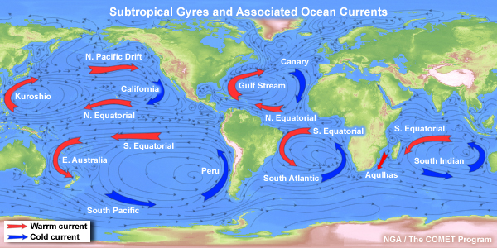
Discussion: What drives the ocean surface currents/circulation?

Slide 7
Surface Winds!!

Slide 8
Reviews
What are the Hadley Cells?
What is the Coriolis force?
When do we need to consider the effect of the Coriolis force?
What are the Ekman currents?
What are the geostrophic currents?
How do the winds drive the ocean surface circulation?

Slide 9
Sources
Winds, rainfall
Drifters

Slide 10
Browsing data

Slide 11
Wind data (JMA)
Japan Meteorological Agency (JMA) – Reanalysis data
http://ds.data.jma.go.jp/tcc/tcc/products/clisys/index.html
Asian monsoon monitoring → Animation maps (Global Area)
SLP & 2-m temperature & 10-m Wind Vector (10-m winds are about surface winds)

Slide 12
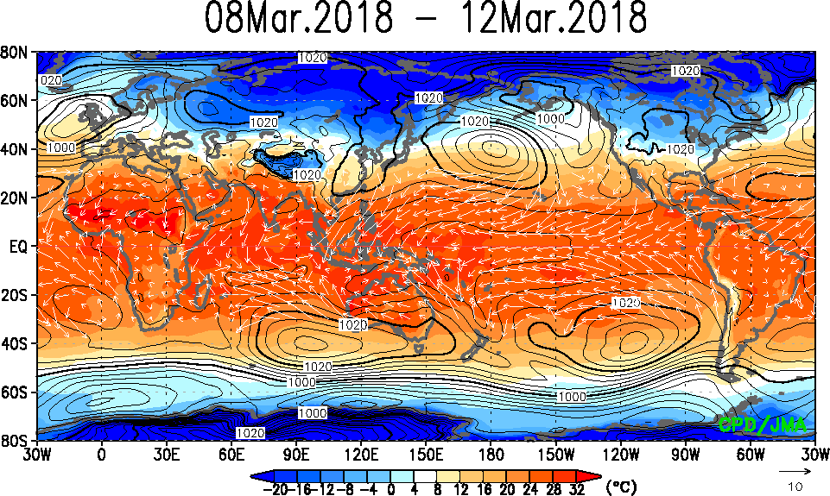
Wind data (JMA)

Slide 13
Wind data (RSS)
Remote Sensing Systems (RSS) – Satellite observation
http://www.remss.com/
Missions → WindSat → Browse Wind vector images

Slide 14
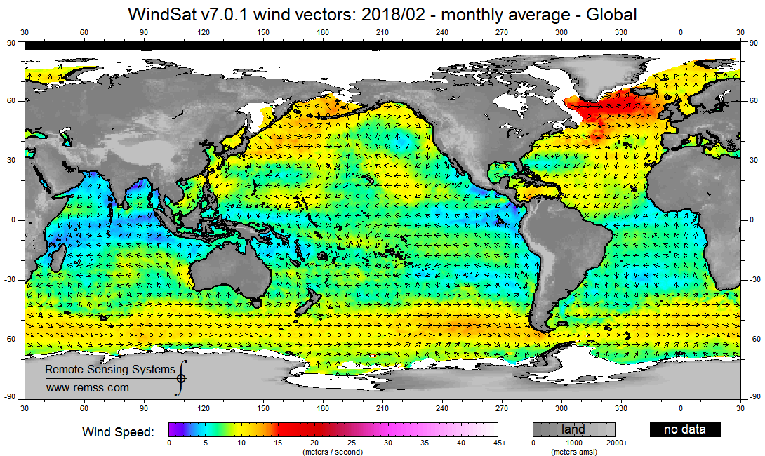
Wind data (RSS)

Slide 15
Rainfall (RSS)
Remote Sensing Systems (RSS) – Satellite observation
http://www.remss.com/measurements/rain-rate/
Browse WindSat

Slide 16
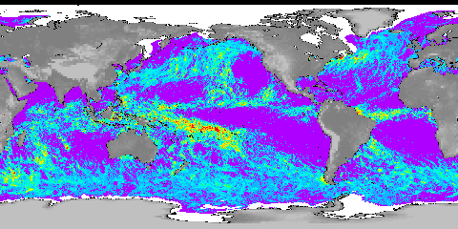
Rainfall (RSS)

Slide 17
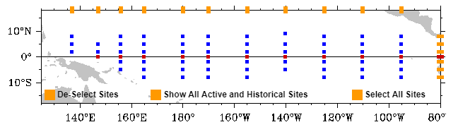
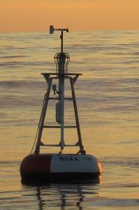
Mooring stations (Tropical regions) (with depth, fixed locations)
Keywords: Global Tropical Moored Buoy Array, TAO array

Slide 18
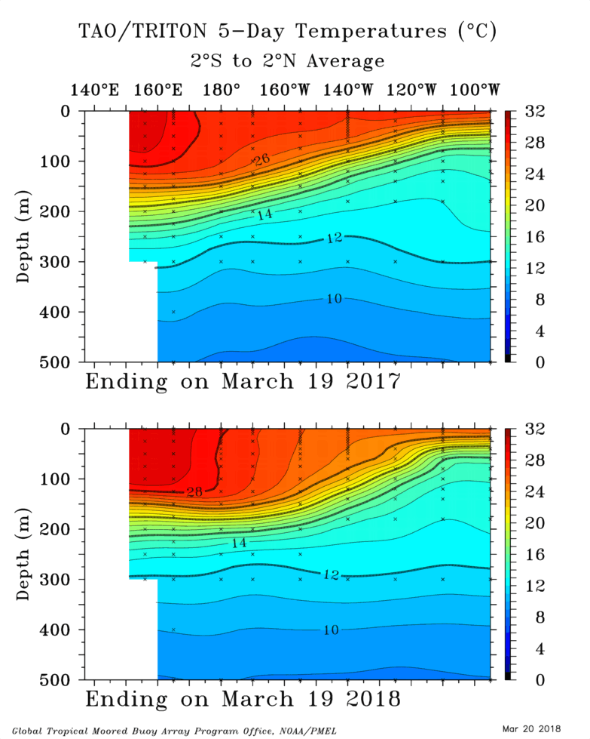
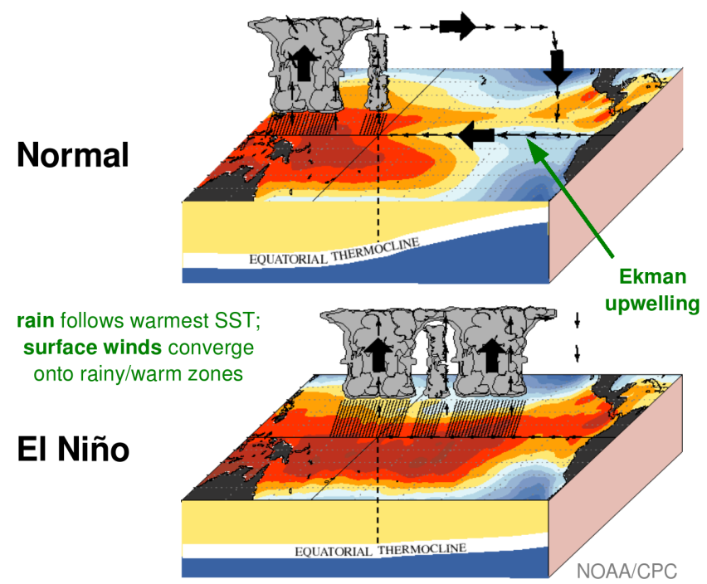
Mooring stations (Tropical regions) (with depth, fixed locations)

Slide 19
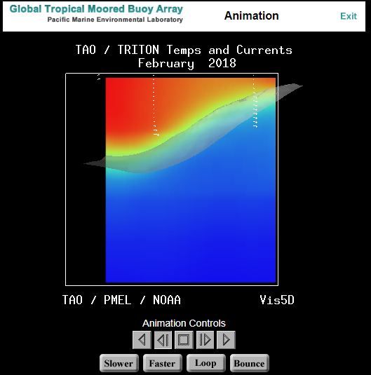
Mooring stations (Tropical regions) (with depth, fixed locations)
Animation Demo
(10~15 mins)
https://www.pmel.noaa.gov/tao/drupal/ani/

Slide 20
分組練習與討論 (20 mins)
Show the monthly mean of surface winds in the Equatorial Pacific in June, 2010. Compare it to that in 2009 June, and describe the differences you see. Guess, what is the response of ocean circulation to these differences of wind fields in the boreal summer in 2009 and 2010.
Show the monthly mean of rain rates in the Equatorial Pacific in June, 2010. Compare it to that in 2009 June, and describe the differences you see.

Slide 21
Downloading and analyzing data
Example using drifter data

Slide 22
Data file formats
General formats for physical oceanography data:
Ascii (txt, csv)***, binary, netcdf***, mat (Matlab).

Slide 23
To see the pattern of Current Variability
Think: What data, parameters or observations we need to see the changing of Kuroshio?

Slide 24
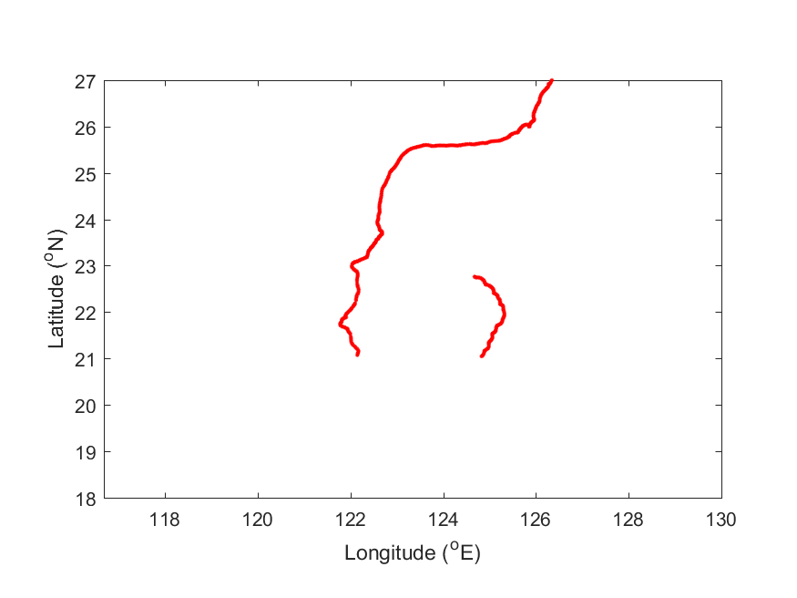
drifter trajectory without map
GUESS: where is it located?

Slide 25
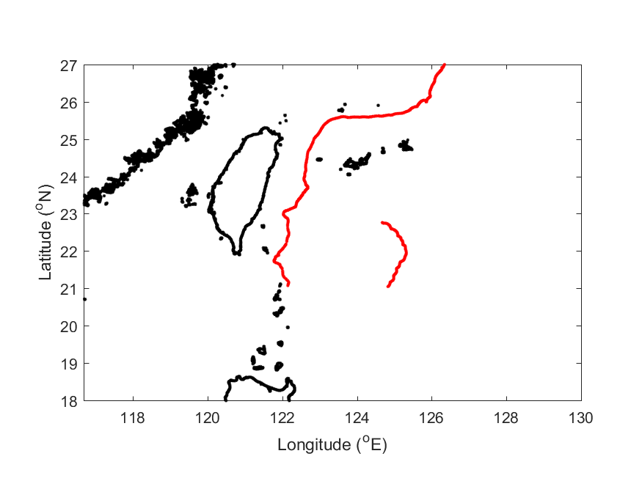
A drifter trajectory with map

Slide 26
Maps/Coastline

Slide 27
Where to get the coastline (keywords: Coastline Resources NOAA)
Download data
Coastline Resources NOAA (Shoreline/Coastline Databases | NCEI)
Download GSHHG data version 2.3.7
gshhg-shp-2.3.7.zip
Install a software
Coastline Resources NOAA (Shoreline/Coastline Databases | NCEI)
GEODAS software tool
Download GEODAS-NG Software Ver 1.1.3
Use the GEODAS-NG software (demonstrate 10~15 mins)
Coastline Extractor → Coastline+ → Import Coast Shapefile → gshhg-shp-2.3.7 → GSHHS_shp → f → GSHHS_f_L1.shp
DEMO: 10 mins

Slide 28
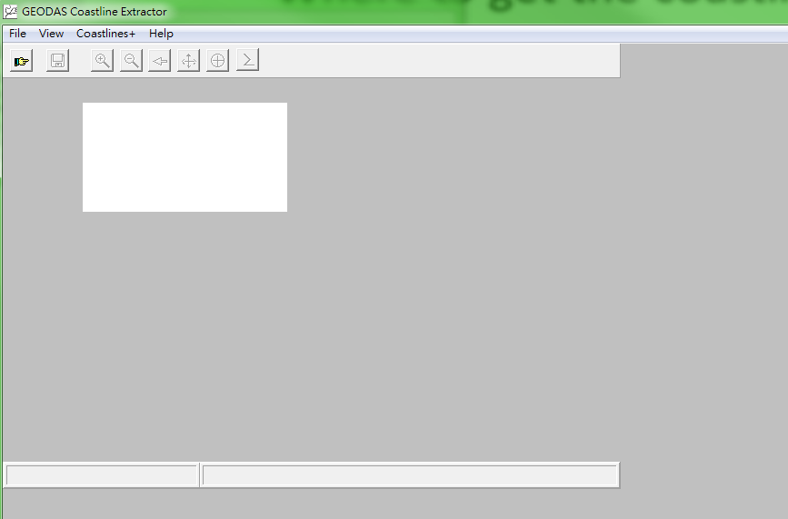
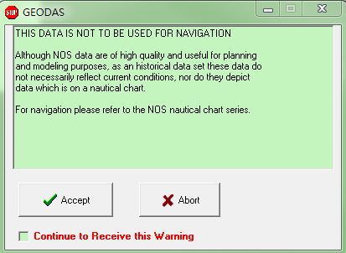
DEMO: 10 mins

Slide 29
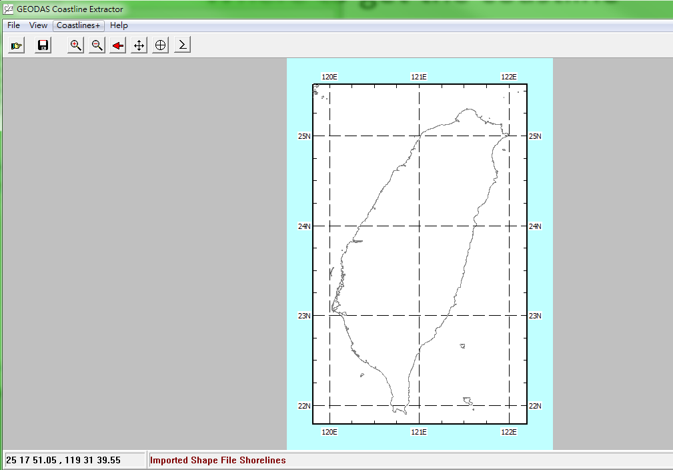

Slide 30
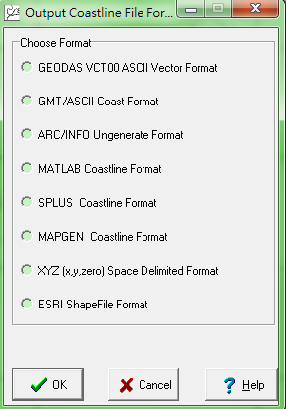

Slide 31
Where to get the coastline (keywords: Coastline/Etopo Resources)
Coastline: http://www.soest.hawaii.edu/pwessel/gshhg/index.html
https://www.ngdc.noaa.gov/mgg/shorelines/gshhs.html
Topo: https://maps.ngdc.noaa.gov/viewers/wcs-client/ (demonstrate 5 mins)

Slide 32
Drifter data

Slide 33
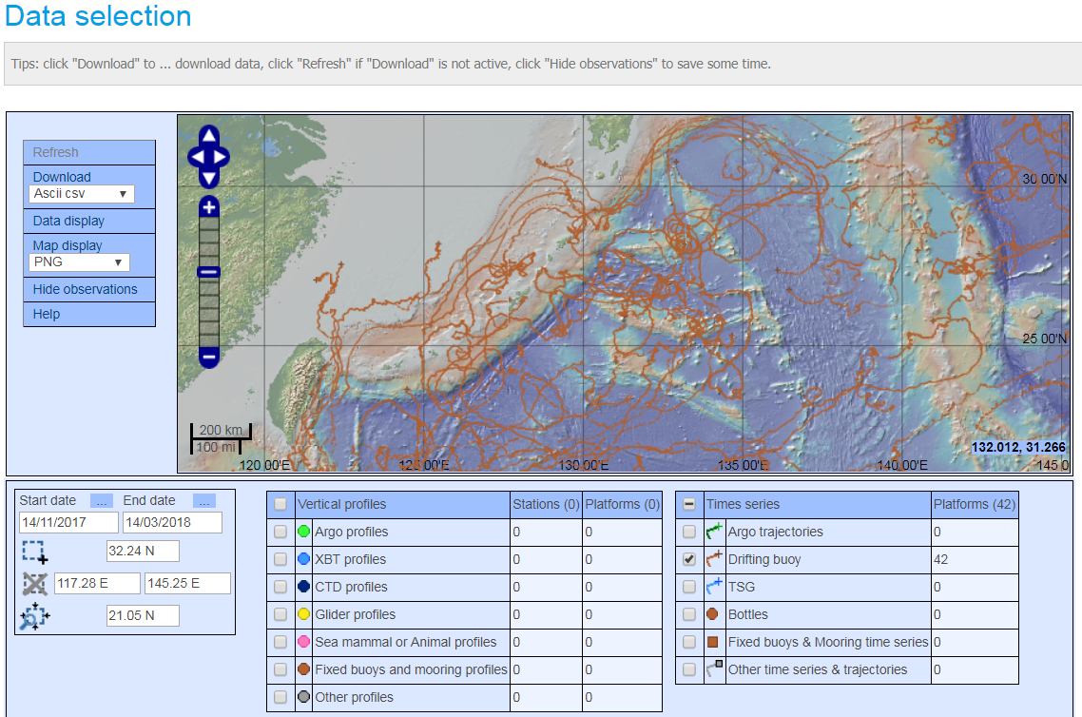
Drifter data (coriolis)
http://www.coriolis.eu.org/Data-Products/Data-Delivery/Data-selection

Slide 34
Homework 4
Plot a map to show the Taiwan coastline
Superimpose two drifter trajectories near to Taiwan (within about 500 km) on the map.

Slide 35
Sources of in-situ observation
Climatological data of Temperature and Salinity (with depth, grids)
Mooring stations (with depth, fixed locations)
CTD, XBT, Argo floats (with depth, non-fixed locations)
Mixed-layer depth
Argos drifters (Done previously)

Slide 36
Climatological data of Temperature and Salinity (Keywords: WOA18)
WORLD OCEAN ATLAS
https://www.nodc.noaa.gov/OC5/woa13/
Demonstrate (10 mins)

Slide 37
Homework 4 (due date:2019/04/10)
Plot a map to show the Taiwan coastline
Superimpose two drifter trajectories near to Taiwan (within 500 km) on the map.
Compare the ocean temperature (at any depth) before 1965 and after 2004. Describe the differences you see.
Send your work in a docx word file (filename: hw04_yourname.docx)
to https://driveuploader.com/upload/lVD4ycOKfP/

Slide 38
Next lesson
Drifter data analysis (Need to bring your laptop with Matlab or some other tools you like to use for programming and plotting)
Try to download some more drifter data and to do some self exercises before coming to class.

Slide 39
Other in-situ data

Slide 40
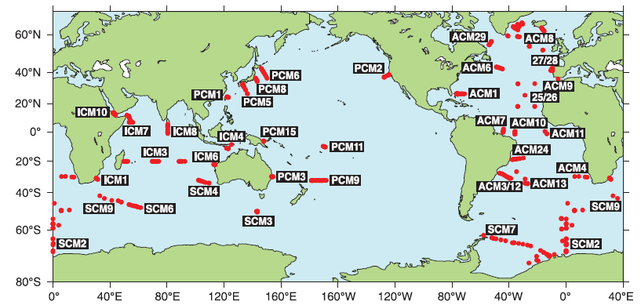
Mooring stations (with depth, fixed locations)
Keywords: WOCE (World Ocean Circulation Experiment)

Slide 41
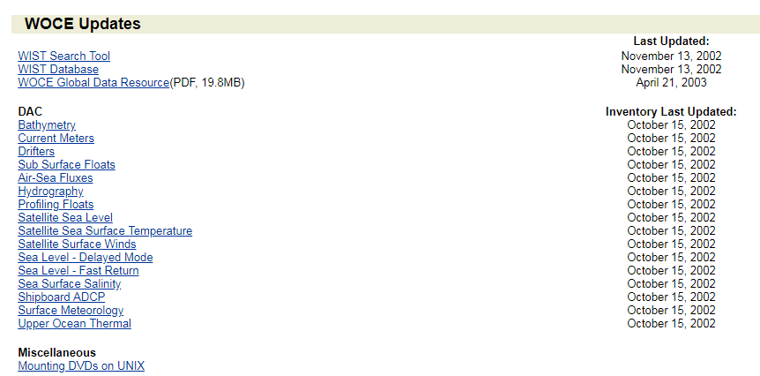
Mooring stations (with depth, fixed locations)
Up to 2002

Slide 42
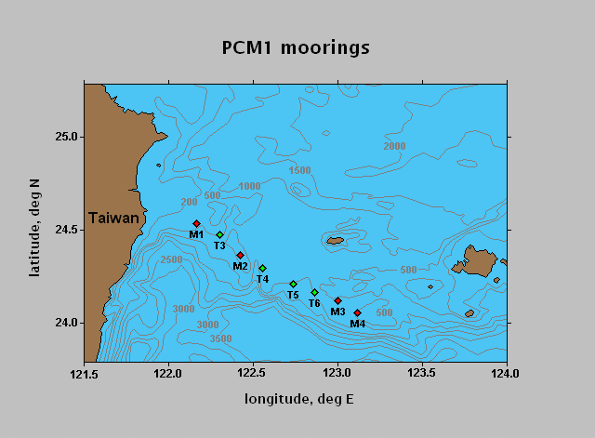
Mooring stations (with depth, fixed locations)
https://www.nodc.noaa.gov/woce/
Demonstrate (10~15 mins)
https://www.nodc.noaa.gov/woce/woce_v3/wocedata_1/cmdac/stranger/explist.htm

Slide 43
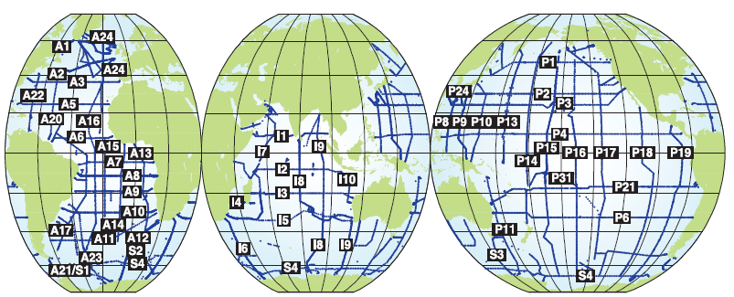
WOCE one-time hydrographic sections
Each line consisted of full-depth stations at typically 100 km spacing measuring temperature, salinity, nutrients, and a suite of chemical tracers. WOCE International Project Office.
WOCE: World Ocean Circulation Experiment

Slide 44
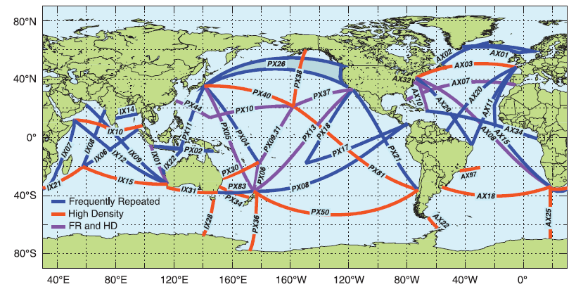
Present-day (2013) XBT network of transects across ocean basins.
The XBTs are deployed from research vessels and ships of the Ship
of Opportunity Program. Some transects include time series with more than 30 years of data
(http://www.aoml.noaa.gov/phod/goos/xbt_network/index.php).

Slide 45
CTD, XBT, Argo floats (with depth, non-fixed locations)
https://www.nodc.noaa.gov/woce/woce_v3/wocedata_1/whp/index.htm
****http://www.coriolis.eu.org/Data-Products/Data-Delivery/Data-selection

Slide 46
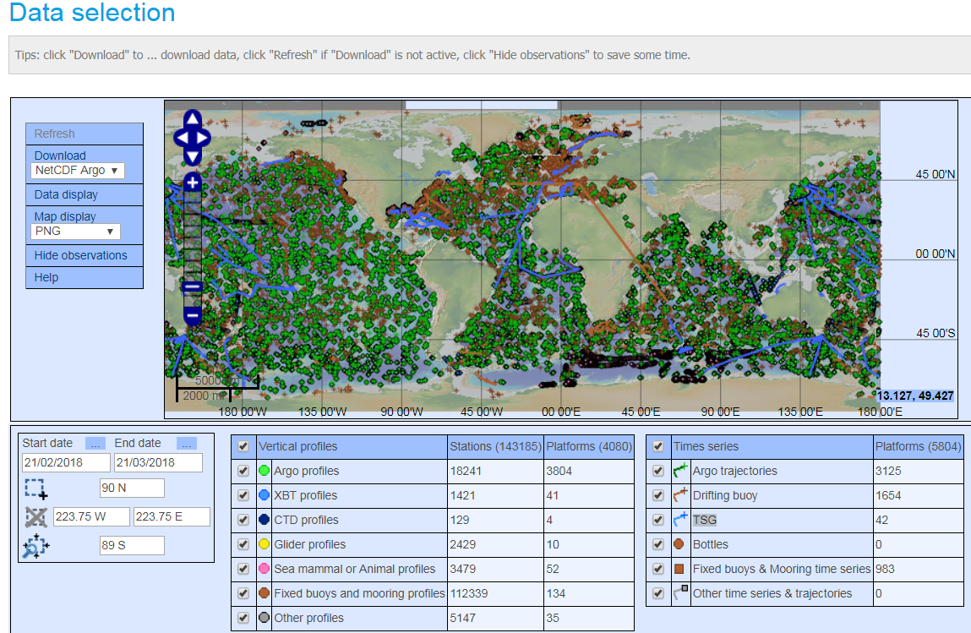
CORIOLIS Data Center (observation)
Demonstrate (10 mins)

Slide 47
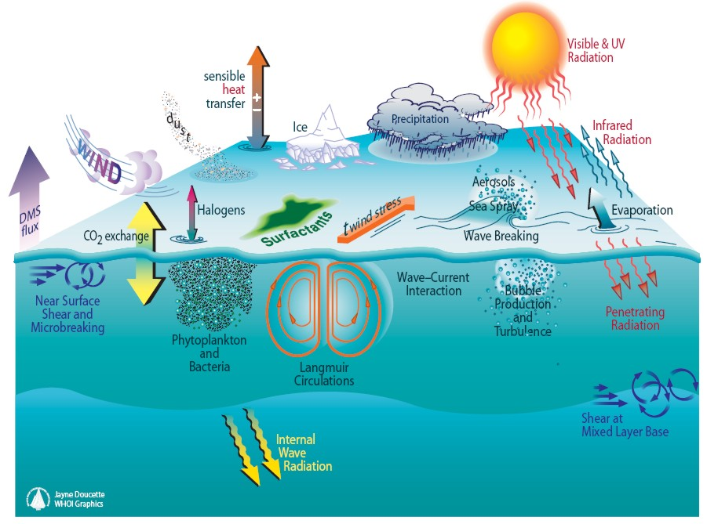
Climatologically Mixed-layer depth
http://www.ifremer.fr/cerweb/deboyer/mld/Surface_Mixed_Layer_Depth.php

Slide 48
Continue next time?

Slide 49
Sources of satellite observations

Slide 50
Sources of satellite observations
SST (Links are similar to those data of rainfall and winds. Keywords: microwave infrared SST)
SSH
Ocean Color

Slide 51
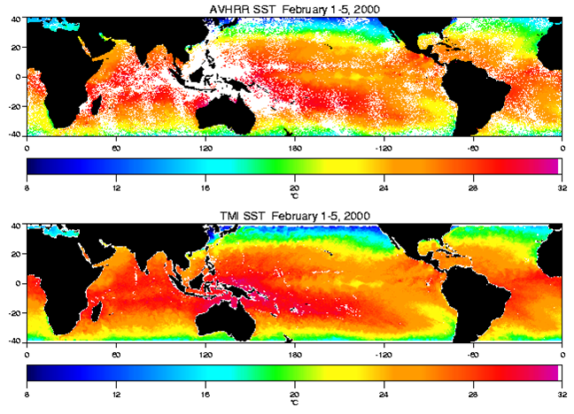
Infrared vs microwave

Slide 52
SST data
http://www.remss.com/

Slide 53
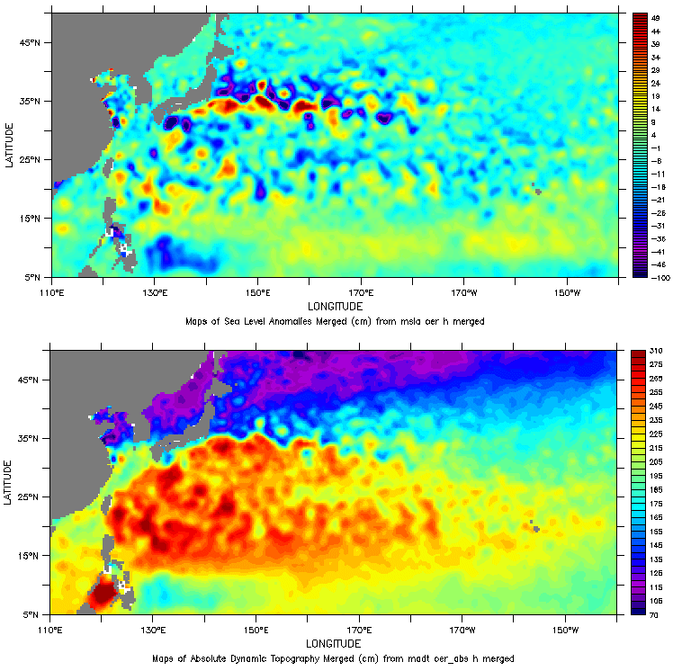
Satellite altimeter data
SLA (sea level anomaly: the variable part of sea surface height)
ADT (absolute dynamic topography: the sum of the variable part and of the constant part)

Slide 54
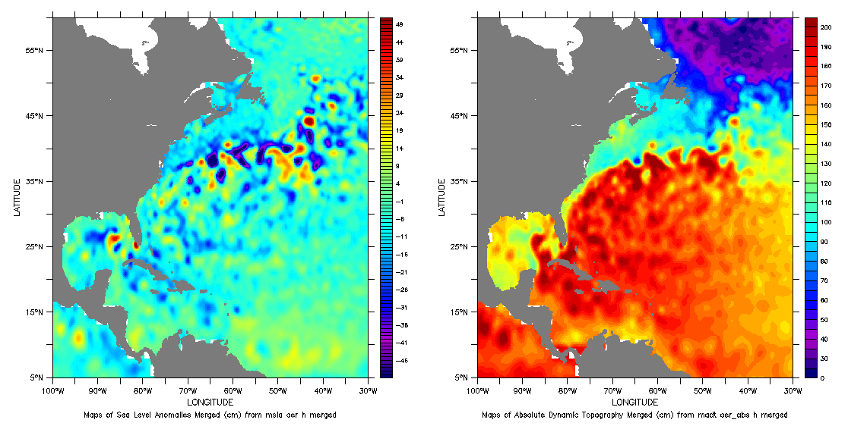
Satellite altimeter data
SLA (sea level anomaly)
ADT (absolute dynamic topography)

Slide 55
Satellite altimeter data

Slide 56
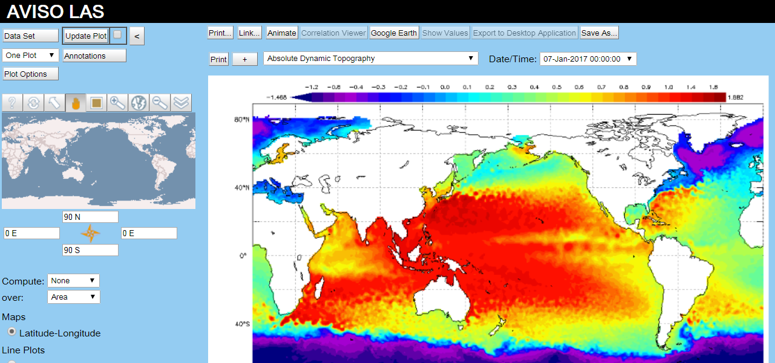
Satellite altimeter data from AVISO
Keywords: AVISO LIVE ACCESS SERVER
Demo (10~15 mins)

Slide 57
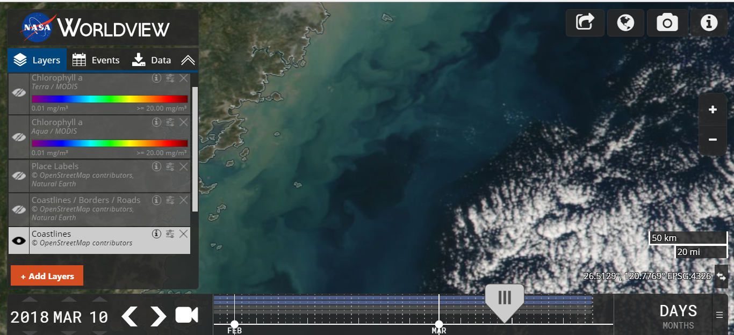
NASA worldview (Ocean color, True color)
https://worldview.earthdata.nasa.gov/
Demo 10~15 mins

Slide 58
分組練習比賽 (30 mins)
Find out a drifter trajectory that was below a typhoon. Calculate the mean speed of the drifter during the typhoon period.
Show the drifter trajectory and the mean speed to the class.

Slide 59
Next lesson
Drifter data analysis (Need to bring your laptop with Matlab or some other tools you like to use for programming and plotting)
Try to download some drifter data and to do some self exercise before coming to class.

